Slide 1
TAXI RIDES APP ANALYSIS
Abdulrahman Sherif

Slide 2
Introduction
Overview : Eda process for Taxi rides app to understand Fare Analysis , Temporal patterns and Geographical patterns
Objective : get insights about the factors that affect Fare amount

Slide 3
EDA PROCESS
1- Data preprocessing :
libraries used ( pandas , matplotlib , seaborn)
Check missing values and duplicates
2- Expolartaroy analysis :
statistics of numerical columns
Distrubtion of categorical columns
Impact of each column according to other
3- insights visualizations :
Fare amounts
Passenger count

Slide 4
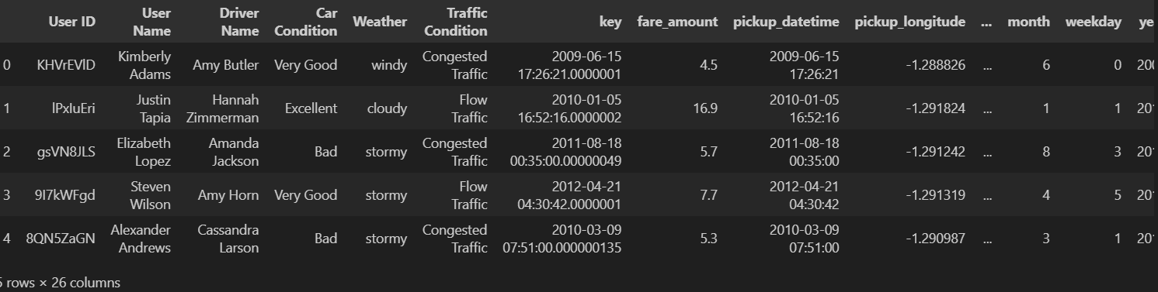

Read data & preprocessing

Slide 5
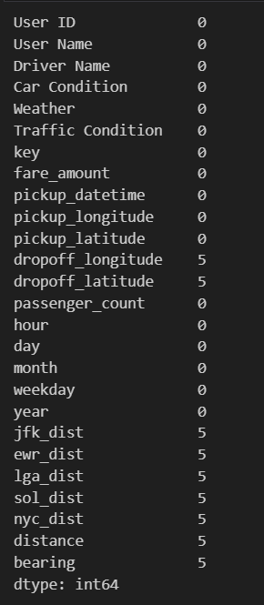
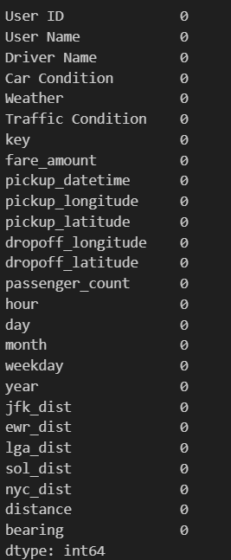

Check missing values & duplicates

Slide 6
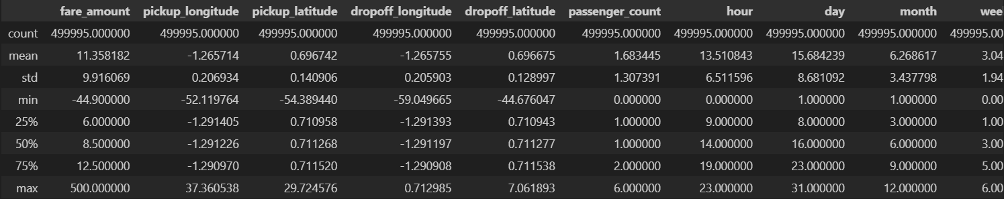
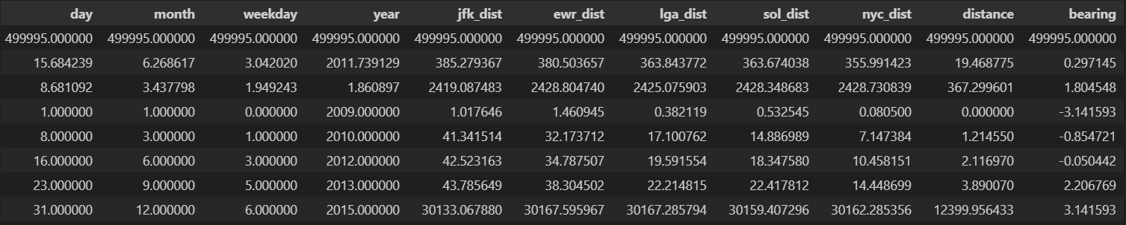
Statistical summary of numerical data

Slide 7
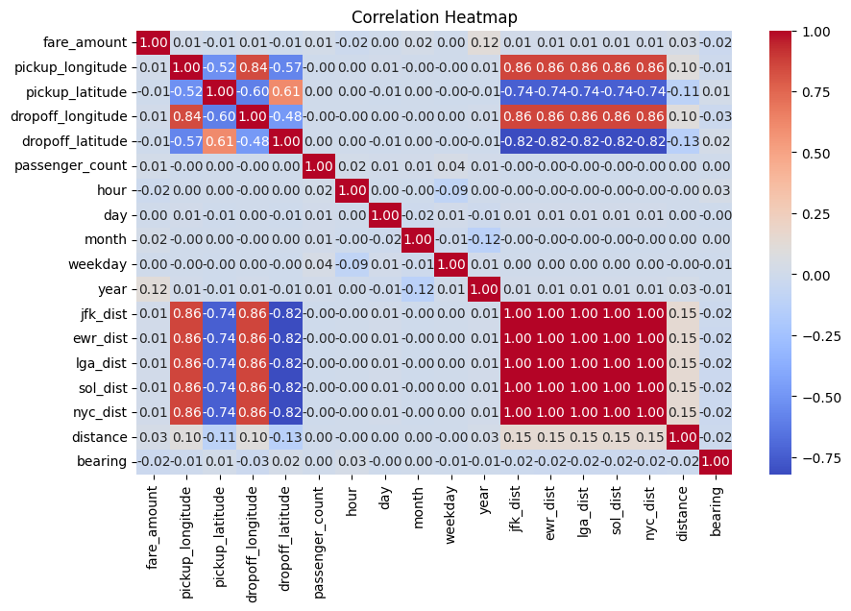
Correlation heatmap

Slide 8
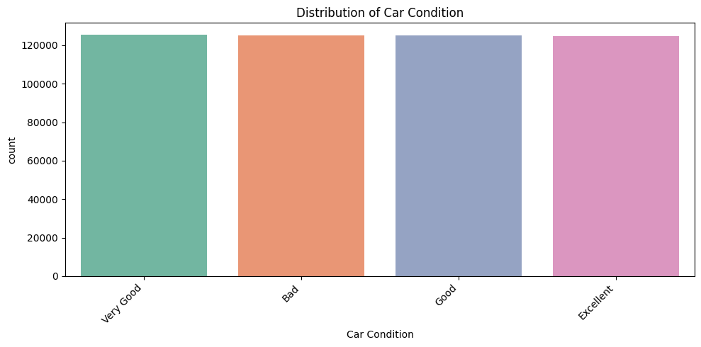
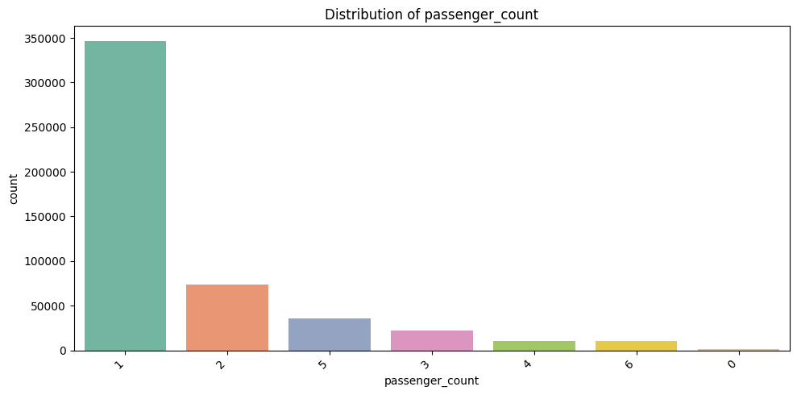
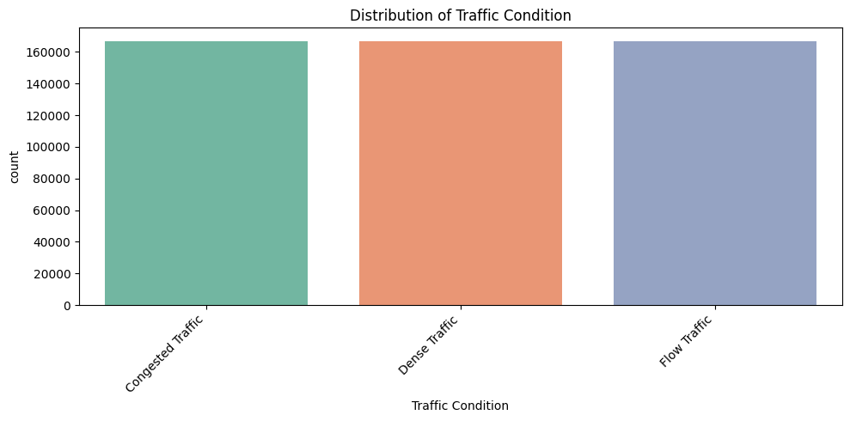
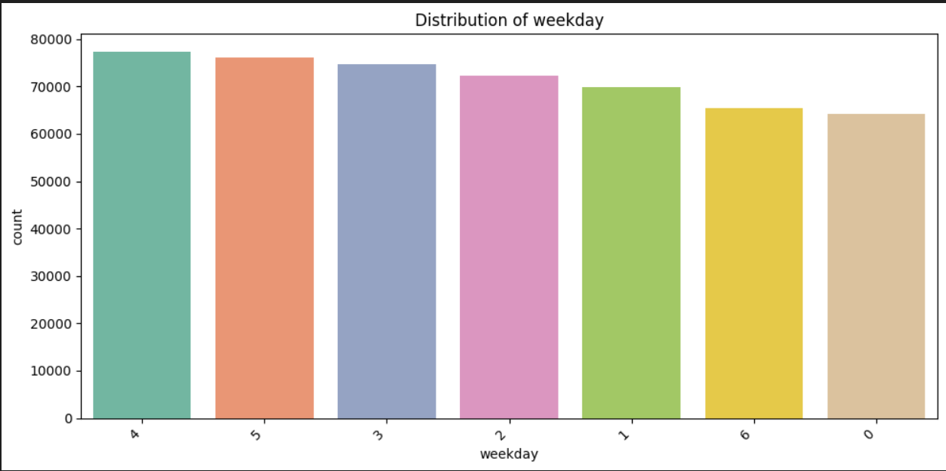
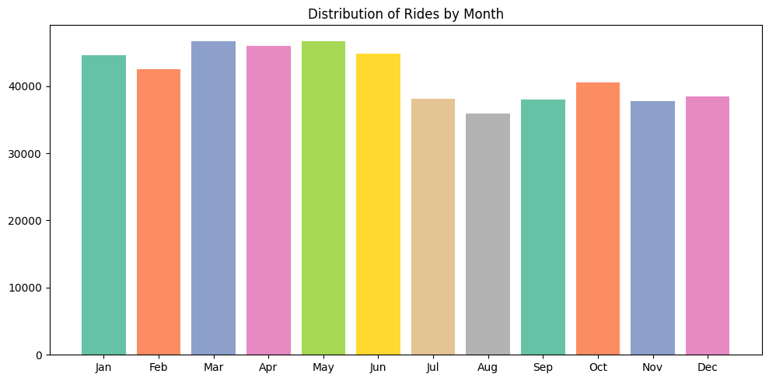
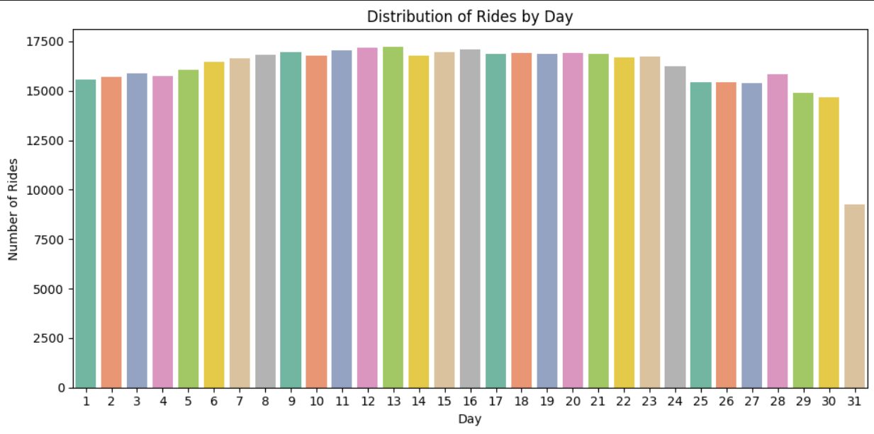
Distrbution of categorical data

Slide 9
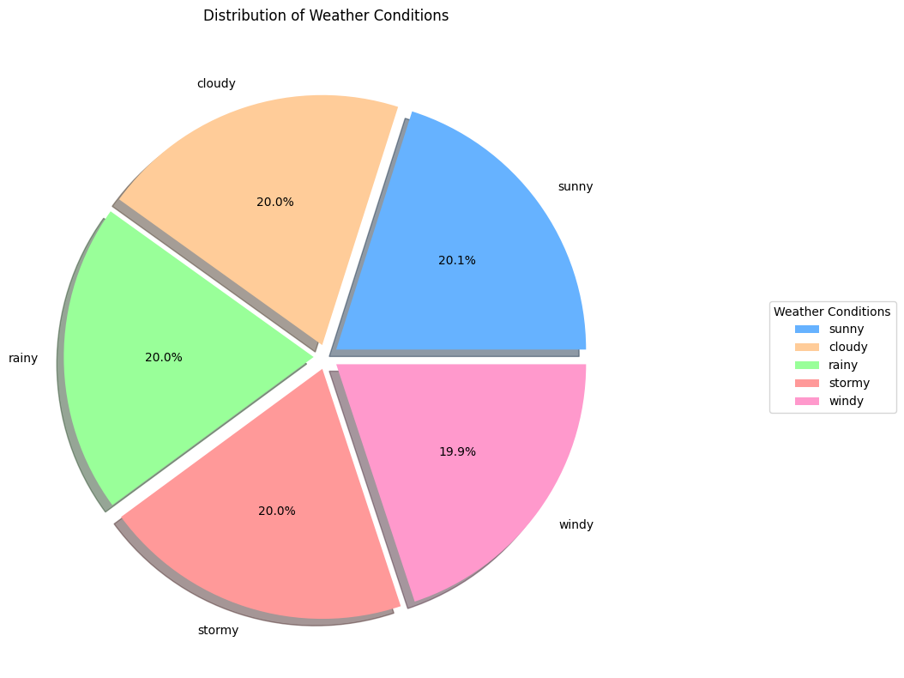
Weather conditions distribution

Slide 10
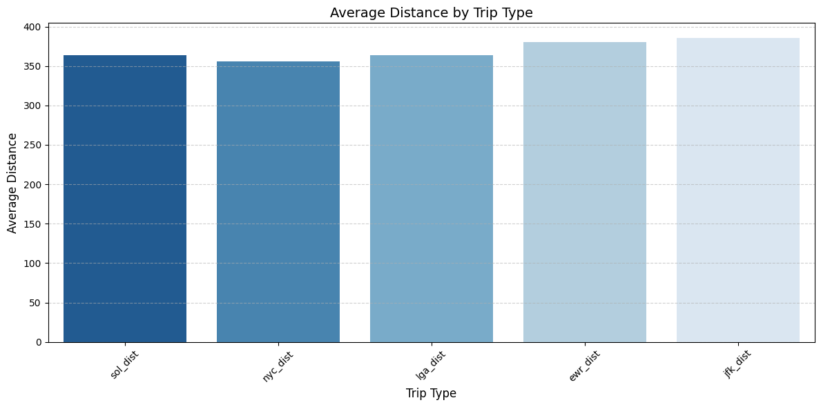
Average distance according to place

Slide 11
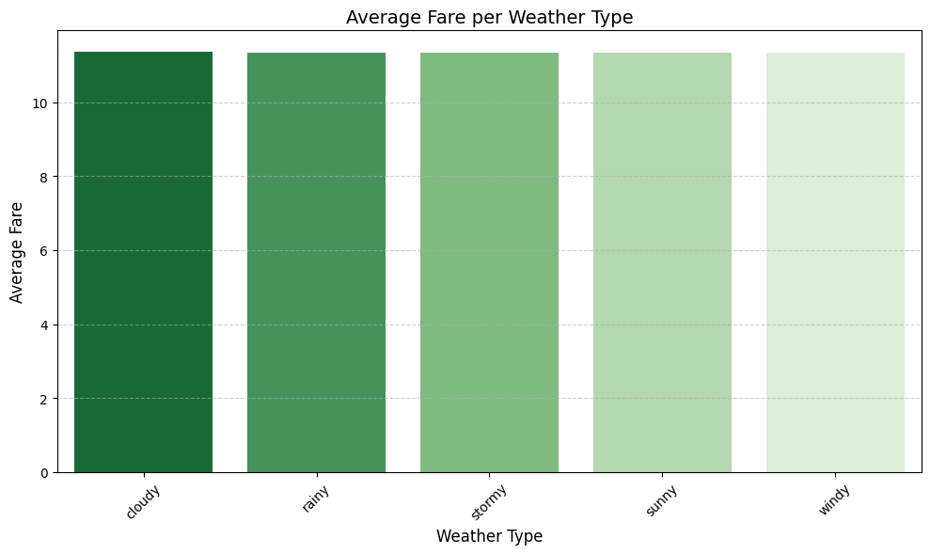
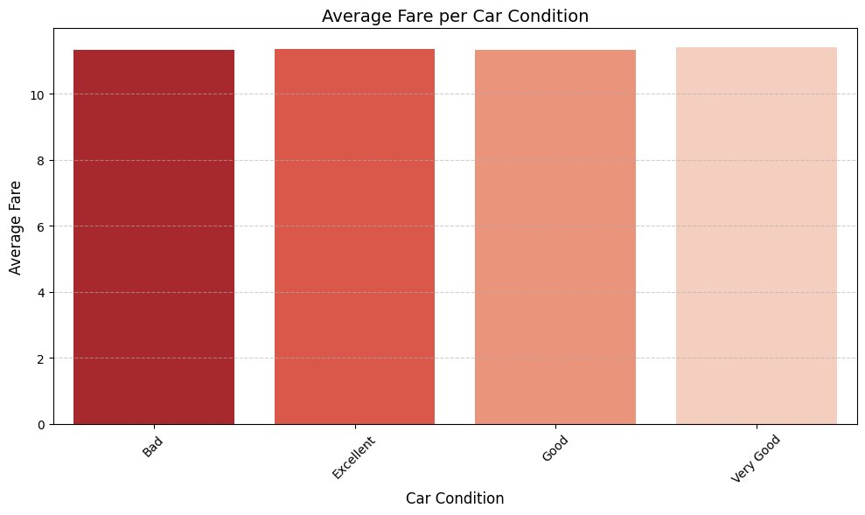
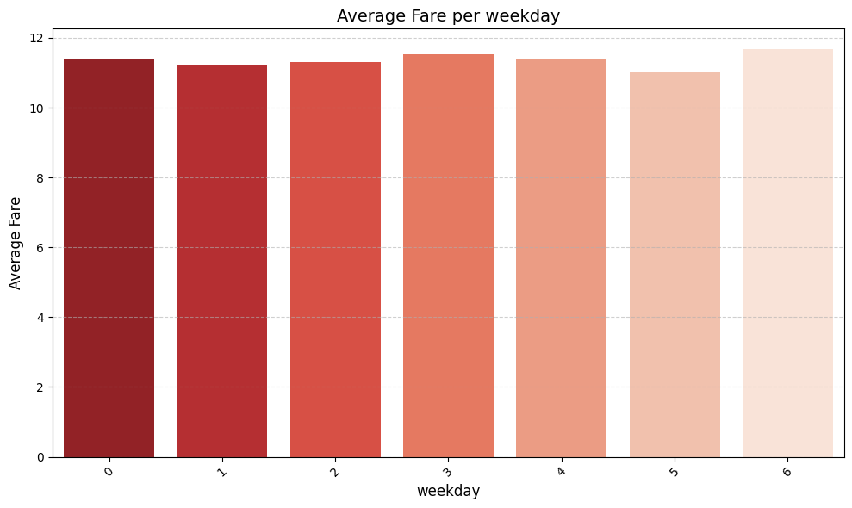
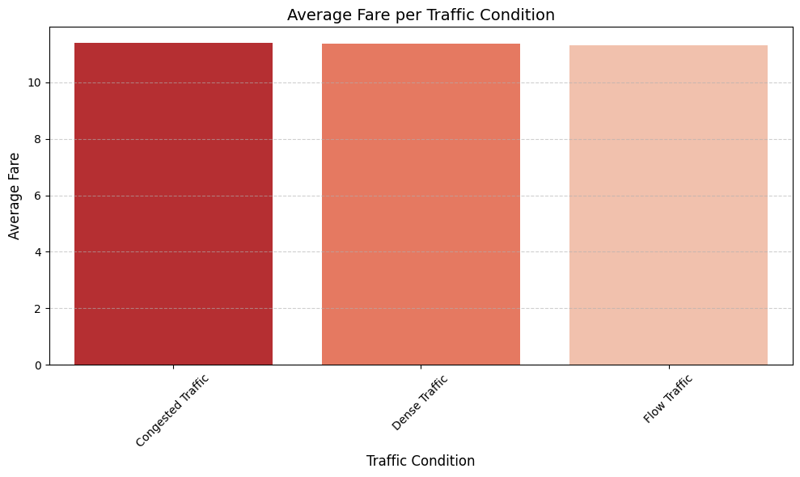
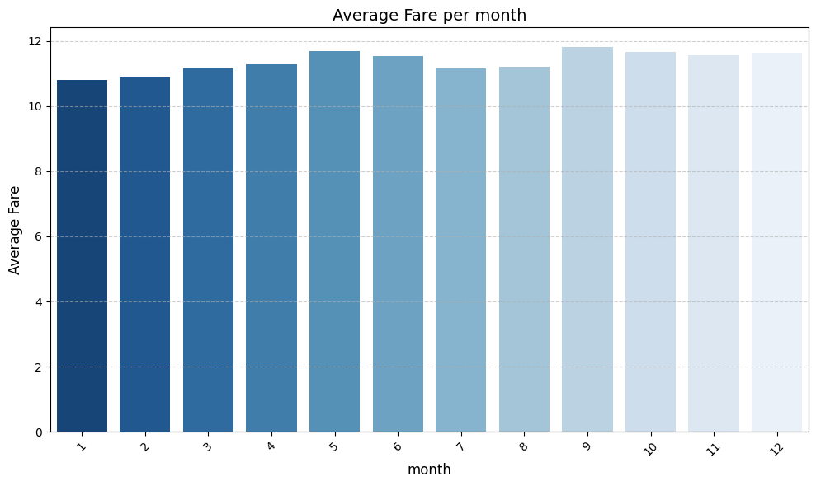
FARE amount analysis

Slide 12
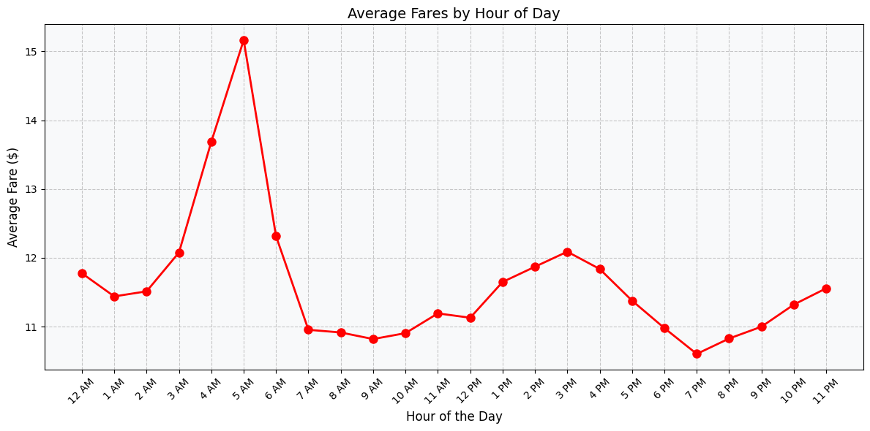
Fare amount according to hour of the day

Slide 13
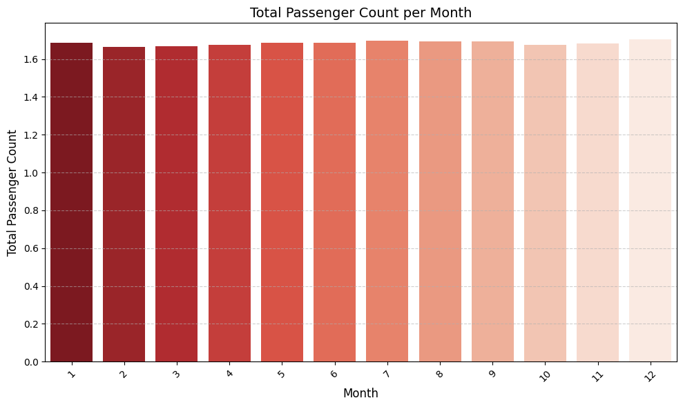
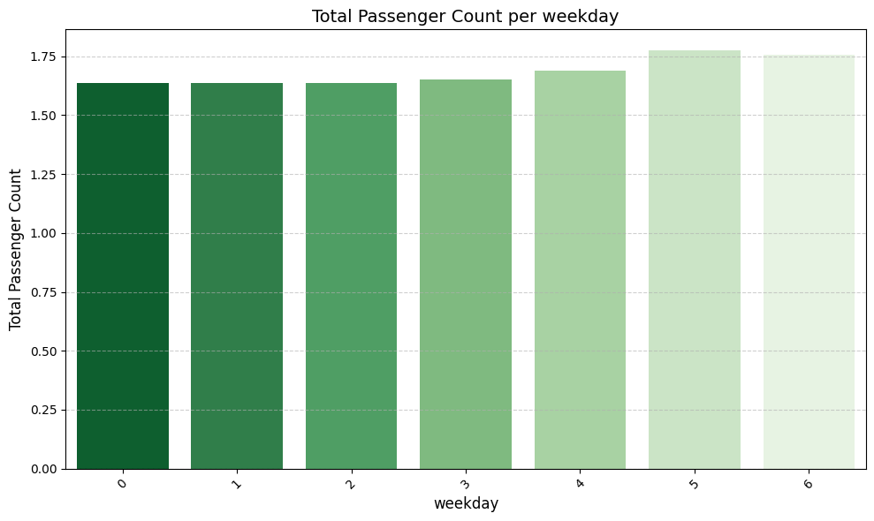
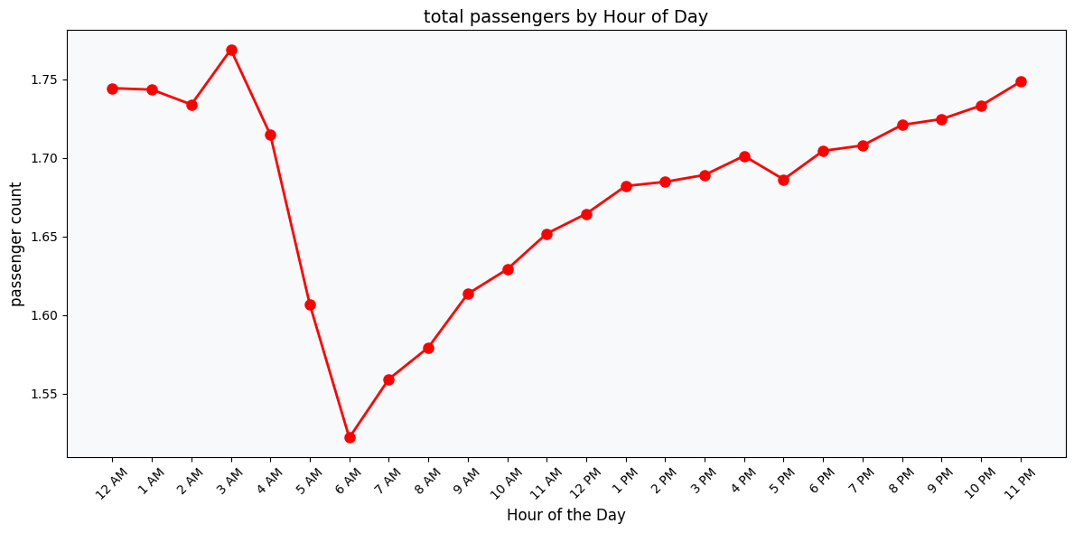
Passenger count in one car analysis

Slide 14
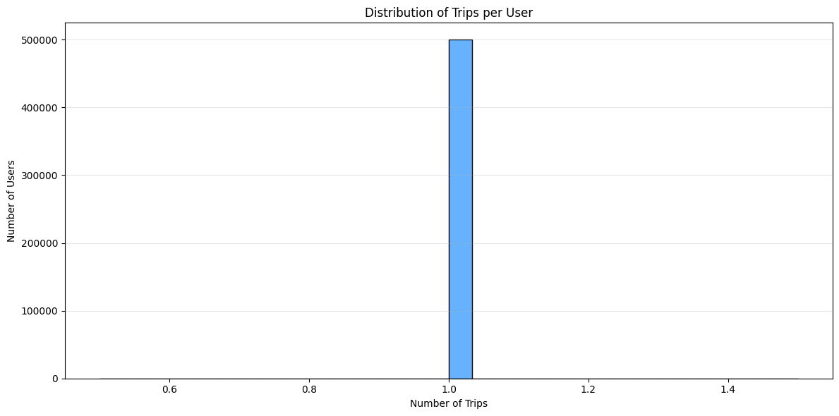
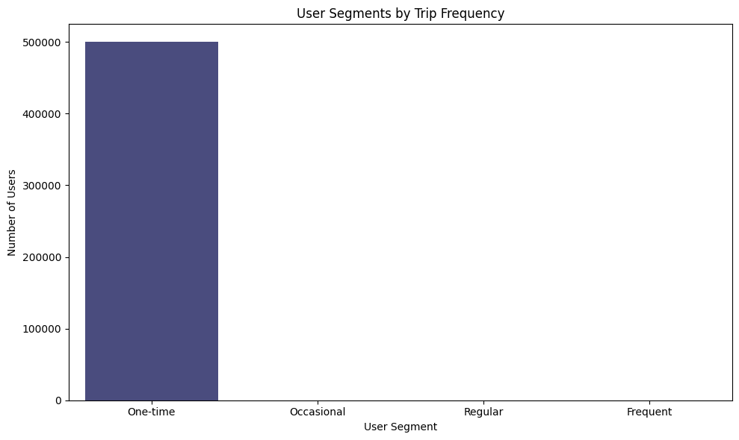
User loyalty

Slide 15
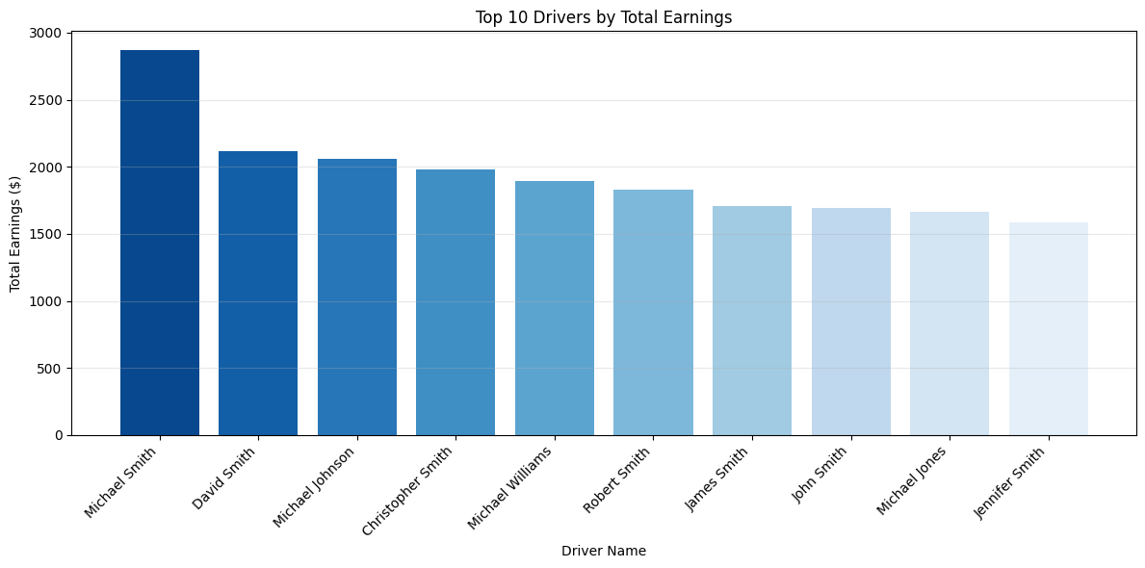
Top drivers according to Earnings

Slide 16
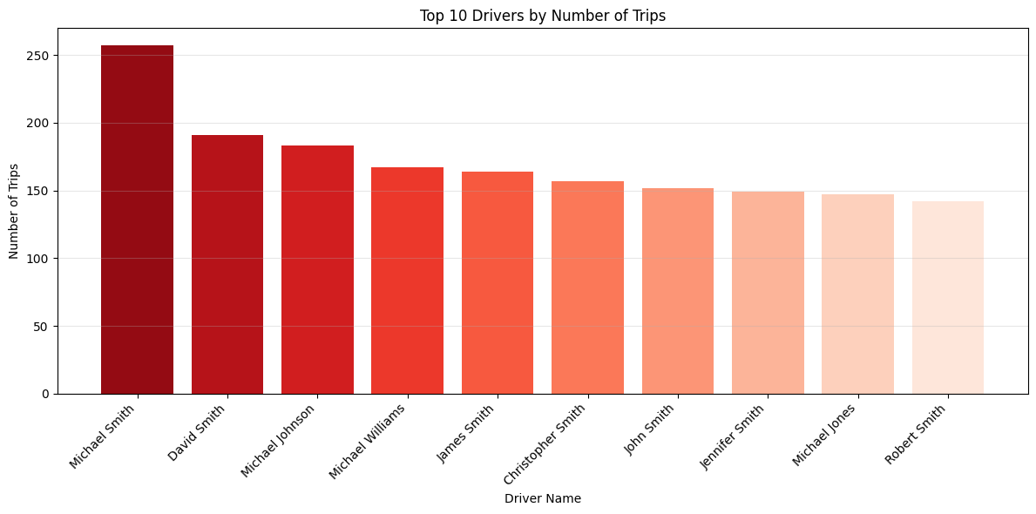
Top drivers according to number of trips

Slide 17
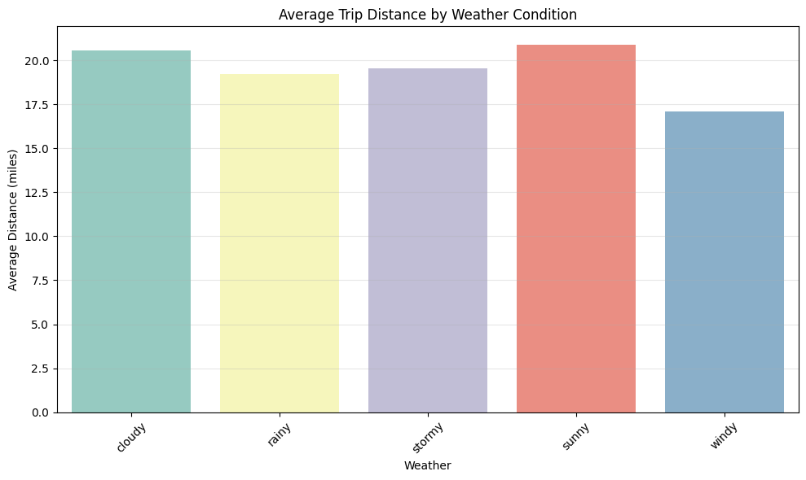
Weather impact on distance

Slide 18
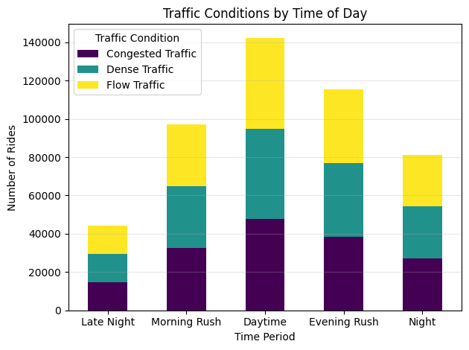
Traffic according to time of the day

Slide 19
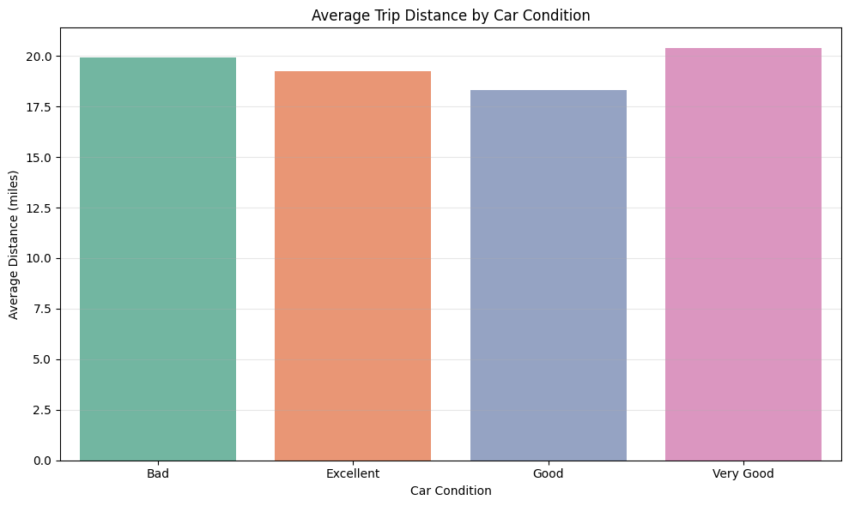
Distance according to car condition

Slide 20
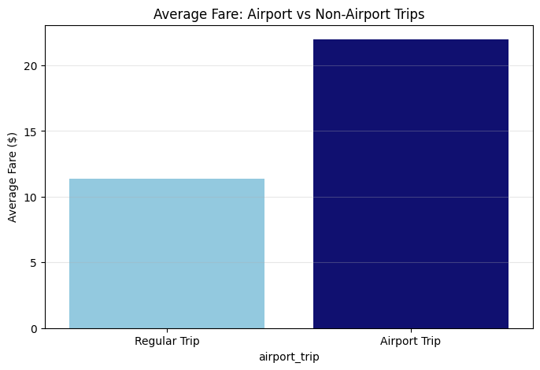
Airport trips fare vs non-airport trips fare

Slide 21
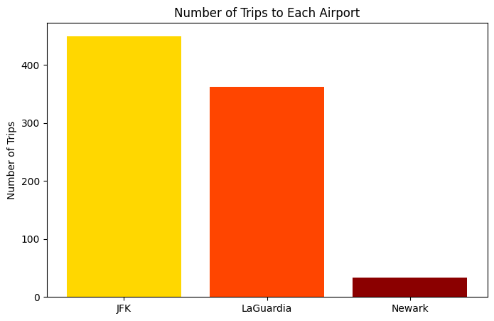
Number of trips to each airport

Slide 22
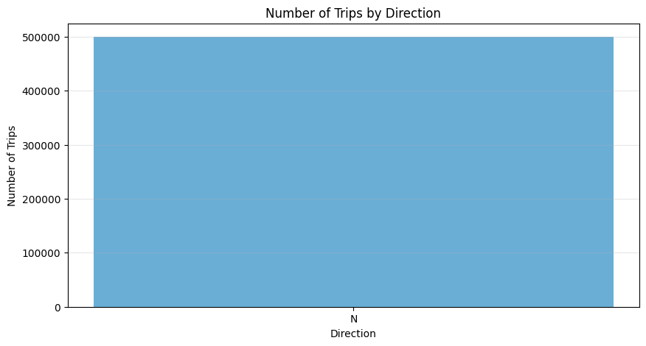
Most direction that have number of trips to

Slide 23
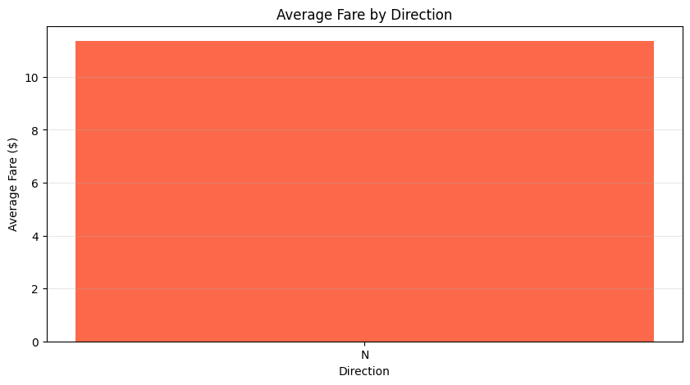
Average fare according to direction

Slide 24
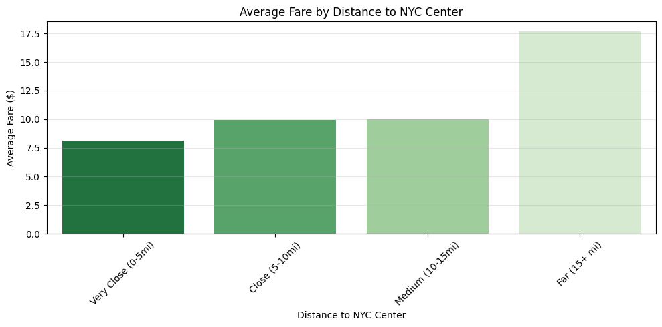
Average fare according to distance to newyork city

Slide 25
Thank you

